Slide 1
Emotion of the Heart
learning the language of the heart

Slide 2
Using Predictive Models to Choose Music Based on Heart Rate
Heart Rate among other body responses is directly influenced by the type of music being heard. [1]
“The stressor caused significant increases in subjective anxiety, heart rate, and systolic blood pressure in male and female controls. These stress-induced increases were each prevented by exposure to music, and this effect was independent of gender
Study by Wendy E. J. Knight Nikki S. Rickard, PhD Monash University
The method described using Pachelbel's Canon in D major

Slide 3
The Methodology, The Data Driven Way
Music tastes of individuals is based on the culture an individual grows up in, while listening to music may be universal, the type of music is not
Using a heart rate monitor and a classification algorithm, an individualized intervention can be used to aid a patient or user of this product

Slide 4
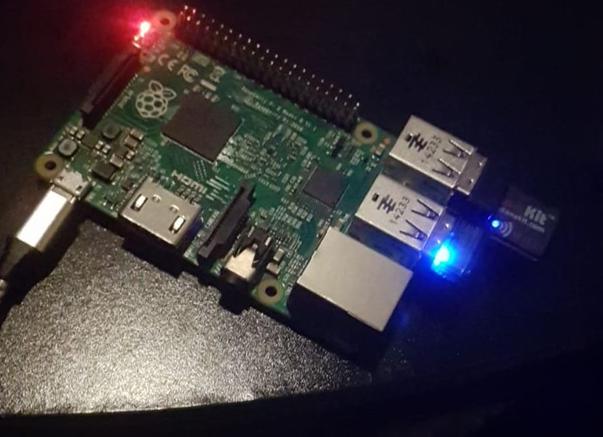
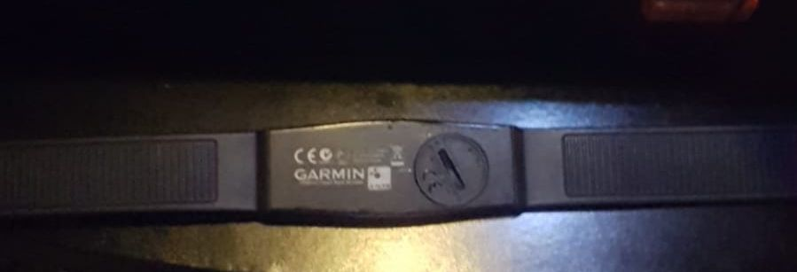
Technology Detailed
This is a Raspberry Pi 3b+ (rPI) running the open source operating system Raspbian with a 32gb sd card for storage of files and music that will not need internet
The rPi currently has an ANT+ usb adapter attached, which is reading heart rate data from a chest strap
A script running on the rPi then returns and updates the current HR at approximately 0.3 second intervals
The model can then queue the next song based on the read HR
There is also an optional Bluetooth adapter attached in order to stream to a separate speaker, but headphones can be plugged directly into the 3.5mm jack
Once this is set up, there is no need for any sort of display
Setup includes the script as well as loading the music and trained model that will pick tracks
A wifi adapter was used as well but only for setup
A newer, faster, model of the rPi has come out that has a wifi and Bluetooth chip built in. (35$ for board, 10$ for ant+ sensor, 55$ for chest strap, 15$ for 32gb microsd card, and 12$ for power cable) but it also will use more battery.

Slide 5
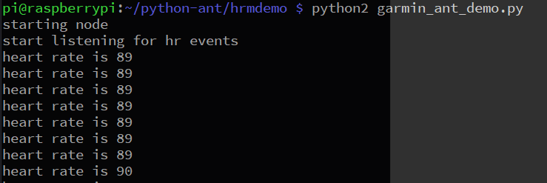
Technology Considerations/Expansions
The current method is to use the data from an ANT+ sensor directly for prototyping but can incorporate and read from current HR/Pulse monitors with some work using the GPIO pins.
Adding music manually can be difficult and so an option is to use a software called Youtube-dl or Spotify to search for songs based on genres/moods or tempo and play them.
The power consumption of this device is very low, the HRM strap used uses a coin cell battery that lasts over a year and the rPi uses about the same energy as charging a cell phone (500 - 700ma/hr)

Slide 6
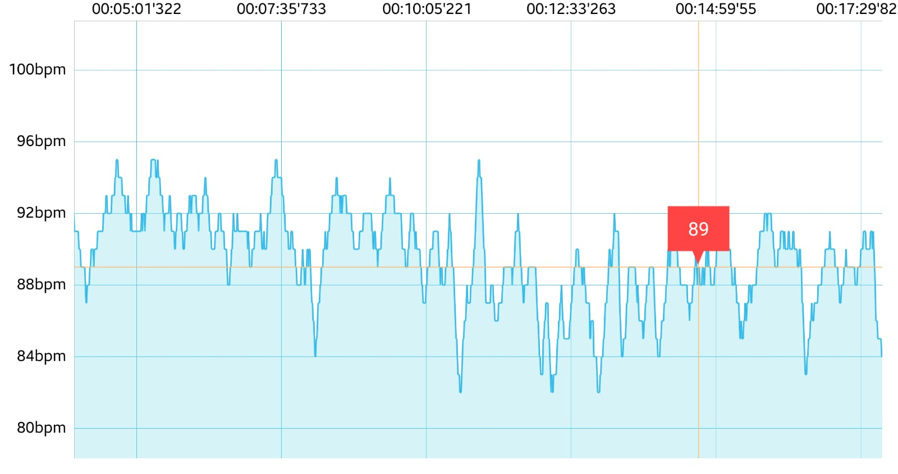
The Training
As this is a proof of concept without sufficient testing data, I used myself as a test subject.
For the first 5 minutes I listened to Max Brhon - Cyberpunk [NCS Release] Music provided by NoCopyrightSounds. https://youtu.be/iqoNoU-rm14 BPM:110
At minute 7 minute I listened on repeat to Elevator Music, Lift Music, No Copyright, Sound Effects Library, Royalty Free Sounds Creative Commons Attribution license (reuse allowed)
https://www.youtube.com/watch?v=LmqvNegW7yY
At minute 12 I listened to a recording released by Nasa to the public domain https://www.nasa.gov/mission_pages/apollo/apollo11_audio.html "The Eagle has landed”

Slide 7
Modeling
We can clearly see cyberpunk music for me elevated my heart rate.
Listening to Elevator Music lowered my heart rate a slightly.
And listening to the Nasa recording continued the trend of lowering slightly.
Based on this model the recommended song I listened to next was essentially white noise. An air to ground loop Nasa recording that sounded mostly like white noise.
*I did not have nearly enough training samples or suggestion options in the model and proper training of this model felt out of scope given the time constraints of the Hackathon.
The fluctuation in HR were not large but there is a trend

Slide 8
Applications to improve patient outcome
Music is a common way of relieving stress but as technology to produce music advances the types of music also become varied more rapidly.
Having machine learning predict music that can reduce a patient’s HR which can benefit the patient, and also a doctor if the patient is being prepped or undergoing a surgery.
Having individualized music helps with aging in place with resilience by helping patients feel in a more familiar environment due to music.
It has already been studied and shown that Classical music has an effect of reducing anxiety but the model can be expanded to detect a rise in HR, such as before and during a panic attack, and preemptively play a song that will help reduce anxiety.
This can also help patients with dementia or Alzheimer's where irritability and anger may cause an increase in HR and the model can be adapted to help them get to a baseline state.

Slide 9
Areas of Improvement
Mood/state of mind can not be explicitly inferred from HR data, HR data can only inform
Extra sensors can add more data to form a clearer picture, specifically obtaining EEG data just during the training phase
The Patient initially may have to listen to a few songs they might not like as the model learns how their HR reacts
Comforting a patient that this will be useful in the longer term may help them keep listening
Not everyone will react equally strongly to music in general, and at times some people may feel they don’t want to listen to any music
In these cases, turning the music off is an option, but expanding the training model to a hobby like reading can help too. It does not have to be limited to music.
It is also important to take into account what the individual is doing physically, as body movement can affect the HR reading, a person sleeping and sitting and standing may have different resting heart rates.
Keeping the model and application simple at first to prove efficacy is necessary, so maybe limit it to people who stay still for long periods of time, ecg. post-op patients
Since I was my own subject of the experiment, I may have chosen songs in a biased way to produce certain results
A larger sample group and study needs to be done to show proper efficacy.

Slide 10
Areas for Exploration/Research
Music isn’t harmful to most patients, as long as volume levels are limited and so the research population that can be sampled from is large. There is low risk to patient health.
The solution of an rPi is portable and so can be used by patients outside of a hospital setting as long as a battery pack and chest strap is worn or while near a wall outlet, but it could also be built into the personal HR/Pulse monitor at hospitals and that monitor would have room for a built in speaker.
Because the concept of music is not limited to a single culture or people. this device can be used across the world and if aggregate data is shared across nations, it can help build better cultural awareness between doctors and patients from different backgrounds
Having logs of when the model triggers a certain song might help patients better understand what events may have lead to an elevated HR
There is no reason that the model has to be limited to relaxing music, patients who suffer from depression may be helped by being suggested songs that bring their heart rate back to baseline
Another application of this model can do the opposite when used during exercise to suggest songs that motivate/increase HR if it sees the HR is lowering by playing higher tempo music.
However that would need an assessment if the HR increased by music was for good vs bad reasons

Slide 11
Citations
Knight, W.E. and Rickard, N.S., 2001. Relaxing music prevents stress-induced increases in subjective anxiety, systolic blood pressure, and heart rate in healthy males and females. Journal of music therapy, 38(4), pp.254-272.
[1]
All heart rate data recording is my own that I collected myself and I release it to the public in a way, similar to https://archive.ics.uci.edu/ml/about.html but not standardized at all.
Track: Max Brhon - Cyberpunk [NCS Release]
Music provided by NoCopyrightSounds.
Watch: https://youtu.be/iqoNoU-rm14
Free Download / Stream: http://ncs.io/Cyberpunk
Elevator Music, Lift Music, No Copyright, Sound Effects Library, Royalty Free Sounds
Creative Commons Attribution license (reuse allowed)
https://www.youtube.com/watch?v=LmqvNegW7yY
Nasa "The Eagle has landed":
https://www.nasa.gov/mission_pages/apollo/apollo11_audio.html
NASA Audio Collection https://www.nasa.gov/feature/nasa-university-of-texas-at-dallas-reveal-apollo-11-behind-the-scenes-audio
https://archive.org/search.php?query=Apollo%2011%20MOCR%20ACR%20Collection

